Slide 1





Kafka

Slide 2
Development background
What /Abstract
Kafka is a distributed Message System. It has the capability of horizontal expansion and high throughput. In addition of the new version of the stream function, it positions itself as a distributed streaming platform to provide real-time pipeline.
Who/Owner(s)
Kafka was originally developed by LinkedIn then donated to the Apache Foundation as open sourced in early 2011. Graduation from the Apache Incubator occurred on 23 October 2012. It is mainly maintained and developed by Linkedin and Confluent.

Slide 3
Development background
When（does it take place）
0.7.x version – It is initial version
0.8.x version -- Kafka 0.8.0 adds a copy mechanism, new version of the Producer API.
0.9.x version – Add safety-related features, kafka connect module and new consumer api
0.10.x version -- Support java 9, enhanced stream api
0.11.x version -- Start to support Exactly-Once semantics, reconstruction of message format
1.x version -- Achieved disk failover, start to support cross-path migration of replicas
2.x version -- The latest version is Kafka 2.4.0, which is also the latest stable version

Slide 4
Development background
Why
Apache Kafka is designed for big data streaming processing which can easily reach tens of thousands of requests per second. Because of its distributed architecture, it is convenient for horizontal expansion and provides high reliability, availability and scalability.
Where
A company can use Kafka to collect logs of various services, record various activities of web users or app users, do real-time monitoring and analysis , record operational monitoring data, and open it to various consumers

Slide 5
Key features and benefits
High throughput and low latency
Scalability
Persistence and reliability
Fault tolerance
High volume

Slide 6
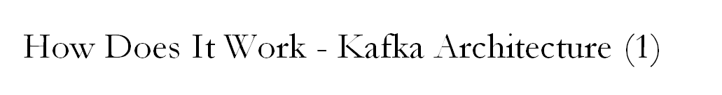
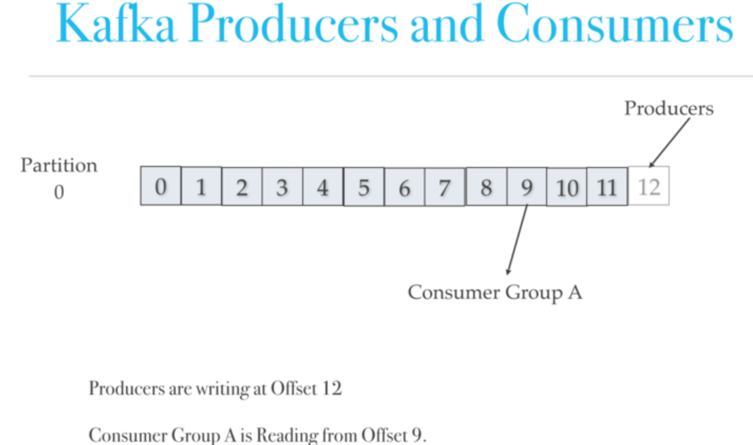
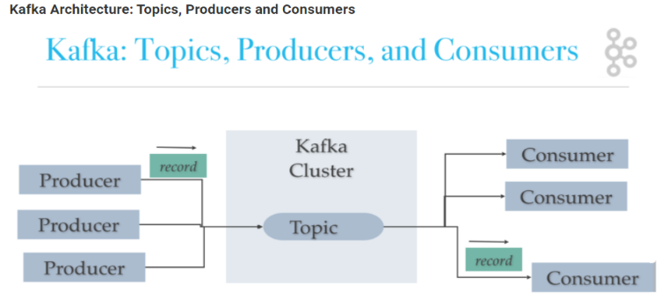
Publish/Subscribe
●Kafka producers
●Kafka topic
(A stream of records and
store in logs )
(A topic log is broken up
into partitions)
●Kafka consumers
Notes:
Kafka producers write to Topics. Kafka consumers read from Topics. A Kafka Topic is a stream of records.
Kafka appends records from a producer(s) to the end of a topic log.
a Kafka topic is a named stream of records. Kafka stores topics in logs. A topic log is broken up into partitions. Kafka spreads log’s partitions across multiple servers or disks. Think of a topic as a category, stream name or feed.
A Topic can have zero or many subscribers called consumer groups. Topics are broken up into partitions for speed, scalability, and size.
Consumers read from Kafka topics and can pick where they are (offset) in the topic log.
Each consumer group tracks offset from where they left off reading.
A topic log consists of many partitions that are spread over multiple files which can be spread on cluster nodes.
Kafka distributes topic log partitions on different nodes in a cluster for high performance with horizontal scalability. Spreading partitions aids in writing data quickly. Topic log partitions are Kafka way for reading and writing to the topic log.
Kafka consists of Records, Topics, Consumers, Producers, Brokers, Logs, Partitions, and Clusters. Records can have key (optional), value and timestamp. Kafka Records are immutable.

Slide 7
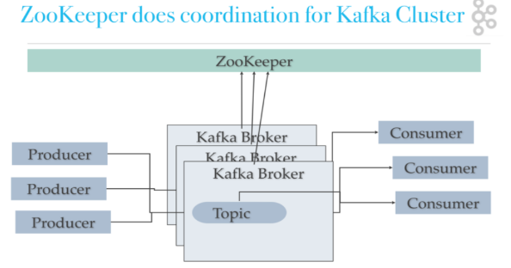
How Does It Work - Kafka Architecture (2)
Kafka Brokers(servers), Kafka Cluster
Kafka uses ZooKeeper for
●Manage the cluster
●Coordinate the brokers/cluster
●Leadership election(provide failover)
(for Broker Topic Partition Leader)
ZooKeeper provides an in-sync view of Kafka Cluster configuration.
ZooKeeper is a consistent file system for configuration information.
Cluster
Notes:
A Broker is a Kafka server that runs in a Kafka Cluster.
Kafka Brokers form a cluster.
The Kafka Cluster consists of many Kafka Brokers on many servers.
Zookeeper provides an in-sync view of Kafka Cluster configuration
Kafka uses ZooKeeper to manage the cluster.
ZooKeeper is used to coordinate the brokers/cluster topology. ZooKeeper is a consistent file system for configuration information. ZooKeeper gets used for leadership election for Broker Topic Partition Leader.

Slide 8
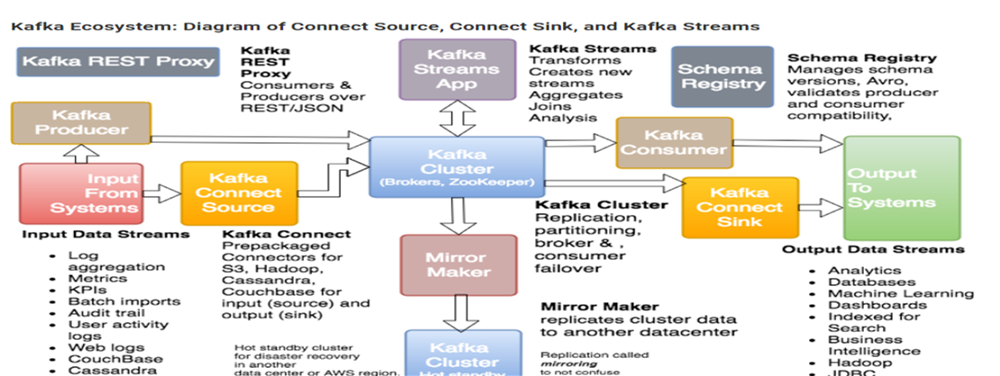
How Does It Work - Kafka Ecosystem
Kafka Streams API to implement stream processing applications and microservices.
Kafka Connect API to build and run reusable data import/export connectors that consume (read) or produce (write) streams of events from and to external systems and applications so they can integrate with Kafka.
Notes:
The core of Kafka is the brokers, topics, logs, partitions, and cluster. The core also consists of related tools like MirrorMaker.
The Kafka ecosystem consists of Kafka Core, Kafka Streams, Kafka Connect, Kafka REST Proxy, and the Schema Registry. Most of the additional pieces of the Kafka ecosystem comes from Confluent and is not part of Apache.
What is Kafka Streams?
Kafka Streams enable real-time processing of streams. It can aggregate across multiple streams, joining data from multiple streams, allowing for stateful computations, and more.
What is Kafka Connect?
Kafka Connect is the connector API to create reusable producers and consumers (e.g., stream of changes from DynamoDB). Kafka Connect Sources are sources of records. Kafka Connect Sinks are a destination for records.
What is the Schema Registry?
The Schema Registry manages schemas using Avro for Kafka records.
What is Kafka Mirror Maker?
The Kafka MirrorMaker is used to replicate cluster data to another cluster.
When might you use Kafka REST Proxy?
The Kafka REST Proxy is used to producers and consumer over REST (HTTP). You could use it for easy integration of existing code bases.
Why is Kafka so fast?
Kafka is fast because it avoids copying buffers in-memory (Zero Copy), and streams data to immutable logs instead of using random access.
How is Kafka getting used?
Kafka is used to feed data lakes like Hadoop, and to feed real-time analytics systems like Flink, Storm and Spark Streaming.
Where does Kafka fit in the Big Data Architecture?
Kafka is a data stream that fills up Big Data’s data lakes.
How does Kafka relate to real-time analytics?
Kafka feeds data to real-time analytics systems like Storm, Spark Streaming, Flink, and Kafka Streaming.
Why is Kafka so fast?
Kafka is fast because it avoids copying buffers in-memory (Zero Copy), and streams data to immutable logs instead of using random access.
How is Kafka getting used?
Kafka is used to feed data lakes like Hadoop, and to feed real-time analytics systems like Flink, Storm and Spark Streaming.
Where does Kafka fit in the Big Data Architecture?
Kafka is a data stream that fills up Big Data’s data lakes.
How does Kafka relate to real-time analytics?
Kafka feeds data to real-time analytics systems like Storm, Spark Streaming, Flink, and Kafka Streaming.

Slide 9
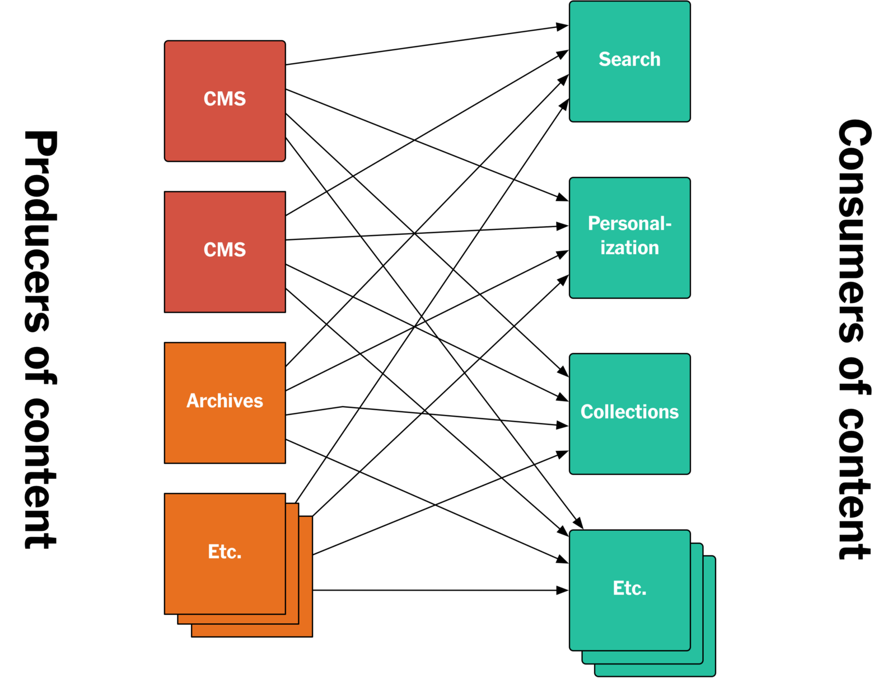
Case Study – The New York Times
Service requirements:
Publish content immediately.
Different back-end services provide
content.
Prioritize content frequently for a search.
Personalization systems.
Notes:
The New York Times used API base before. Different back-end systems have different requirements for accessing content, such as: 1. They have a service that provides live content for the web site and the native applications. This service needs to make assets available immediately after they are published, but it only needs the latest version of each asset. 2. They have different services that provide lists of content. Some of these lists are manually created, some are query-based. For the query-based lists, whenever an asset is published that matches the query, requests for that list need to include the new asset. Similarly, if an update is published causing the asset no longer to match the query, it should be removed from the list. They also have to support changes to the query itself, and the creation of new lists, which requires accessing previously published content to regenerate the lists. 3. When publishing content, they need to prioritize indexing for search engines. 4. They have personalization systems that only care about recent content, but that need to reprocess this content whenever the personalization algorithms change.

Slide 10
Case Study – The New York Times
The problem with API-based approaches:
Need to know all the different APIs
and idiosyncrasies.
Difficult to access previously published
content.
Notes:
From the perspective of system architecture, every system that needs to access content must know all these different APIs and their idiosyncrasies, and then they need to deal with the normalization between different schemas.
An additional problem was that it was difficult to get access to previously published content. Most systems did not provide a way to efficiently stream content archives, and the databases they were using for storage wouldn’t have supported it . Even if you have a list of all published assets, making an individual API call to retrieve each individual asset would take a very long time and put a lot of unpredictable load on the APIs.
These are the problems they encountered.

Slide 11
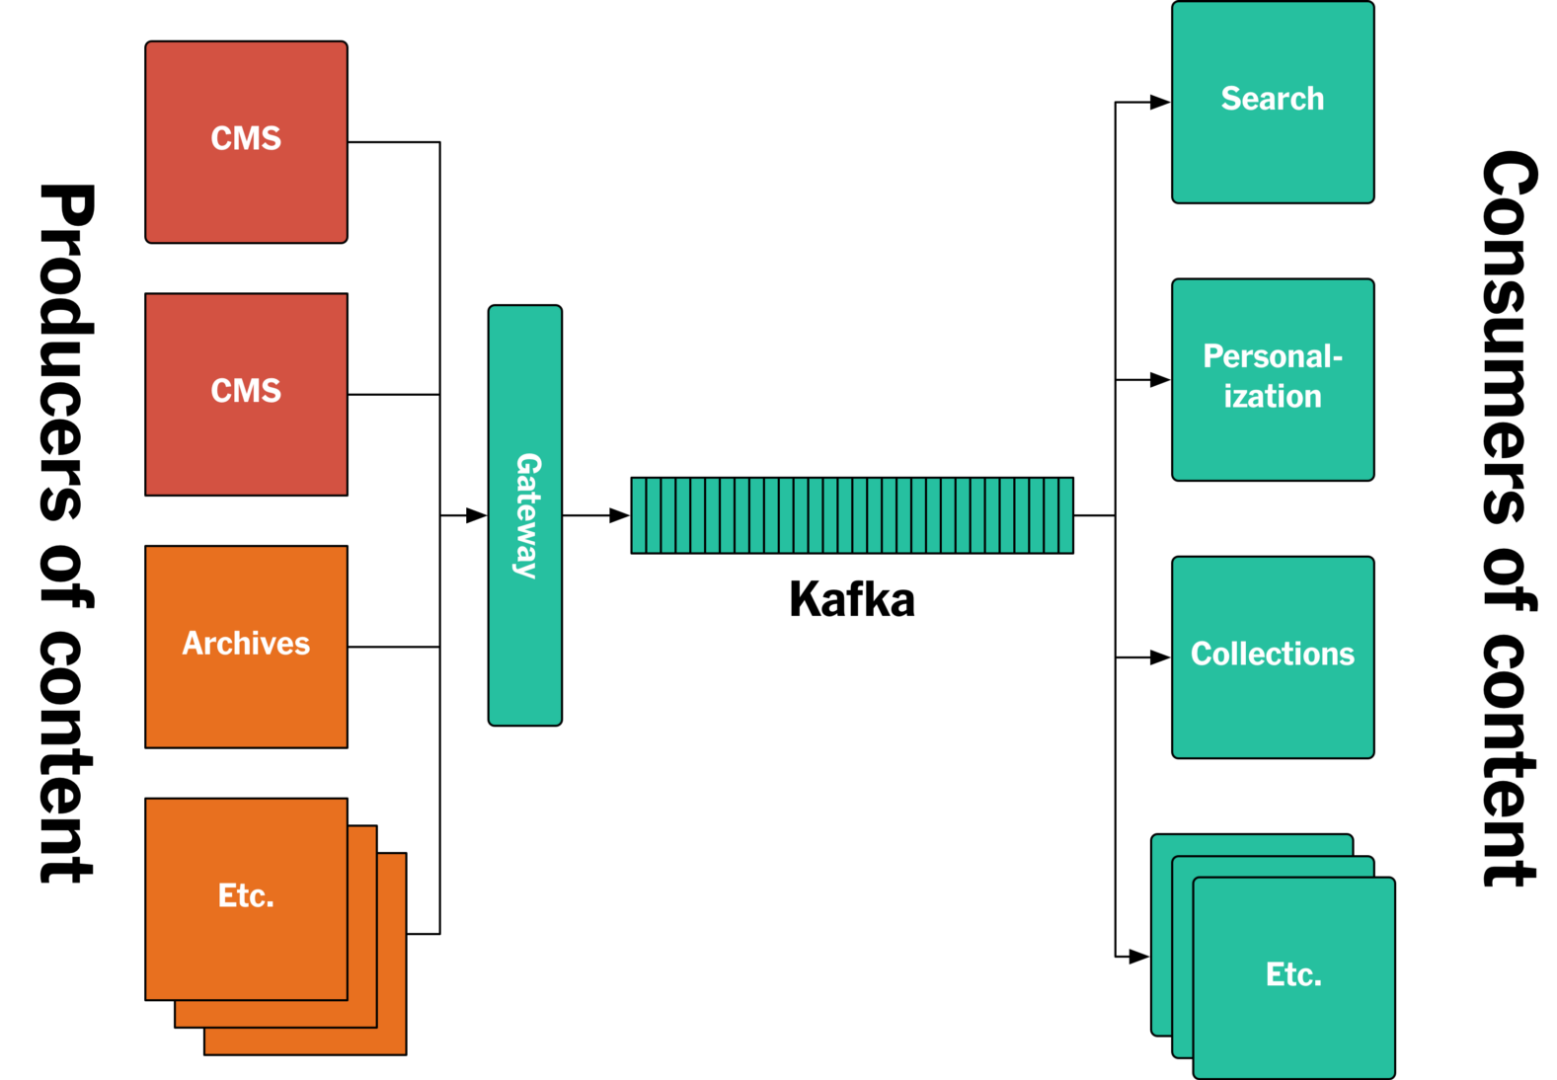
Solution - Kafka's log-based architecture
Notes:
In this case the log is Kafka, and all published content is appended to a Kafka topic in chronological order. Other services access it by consuming the log.
A database typically stores the result of some event, the log stores the event itself — the log therefore becomes an ordered representation of all events that happened in the system. Then, using this log, any number of custom data stores can be created.
These stores become materialized views of the log — they contain derived, not original content. If you want to change the schema in such a data store, you can just create a new one, have it consume the log from the beginning until it catches up, and then just throw away the old one.
A log-based architecture simplifies accessing streams of content. In a traditional data store, accessing a full dump and accessing live data are distinct ways of operating. An important facet of consuming a log is that this distinction goes away. You start consuming the log at some specific offset — this can be the beginning, the end, or any point in-between — and then just keep going. This means that if you want to recreate a data store, you simply start consuming the log at the beginning of time.

Slide 12
Study Comments
Comparison with
RabbitMQ
Pulsar
Impact to us from our study and understanding
Short Summary
Notes:
Thank Livia brought us the good example of applying Kafka. Now it’s my turn to share our comments with you.
In my section, firstly, we compare Kafka with RabbitMQ and Pulsar, Then I will share the impact to us from our study and understanding, and end with a short summary of our presentation today.
Now let’s go to the first part, the comparison with RabbitMQ and Pulsar.

Slide 13
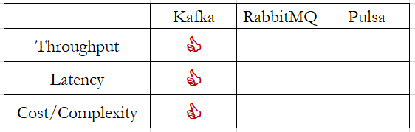
Study Comments - Comparison with other systems
Notes:
From this table, it is very obvious that the performance of Kafka is the best comparing with RabbitMQ and Apache Pulsar. Rabbit MQ is a traditional message broker, and Apache Pulsar is one of the Apache BookKeeper™ based message brokers.
According to the blog of Confluent, if we talk about throughput, Kafka provides the highest throughput of all systems, writing 15x faster than RabbitMQ and 2x faster than Pulsar.
Next point is latency. Kafka provides the lowest latency at higher throughputs, while also providing strong durability and high availability. Kafka in its default configuration is faster than Pulsar in all latency benchmarks, and it is faster up to 99.9% when set to fsync on every message. RabbitMQ can achieve lower end-to-end latency than Kafka but only at significantly lower throughputs.
And then we talk about cost and complexity. Cost tends to be an inverse function of performance. Kafka as the system with the highest stable throughput, offers the best value (i.e., cost per byte written) of all the systems, due to its efficient design. In fact, Twitter’s Kafka journey of moving away from a BookKeeper-based architecture like Pulsar corroborates our observations that Kafka’s fewer moving parts lower its cost significantly (up to 75% in Twitter’s case). Additionally, the work on removing ZooKeeper from Apache Kafka (see KIP-500) is well underway and further simplifies Kafka’s architecture.
Next we are going to share what we think about Kafka.

Slide 14
Study Comments
Impact to us from our study and understanding
Kafka makes internet works like human brain and be able to handle more things at the same time, comparing with human brain.
15 years ago……….
How did you know which travel agency offer the best price of the hotel you like?
How did you know the shortest path you should take when you plan a trip from your home to NTUT
Kafka brings us convenience and efficiency.
Notes:
Before studying what Kafka is, we never thought about why internet can offer us so many amazing functions. But now, we notice it is Kafka making internet works like human brain and even better than human brain. It can process lots of information at the same time. but in the same situation human being must rely on pen and papers.
Let’s go back to 10 years ago……….，
When we were planning a trip and needed to book hotel rooms, how did we know which travel agency offer the best price of the hotel we like? usually we visited hotels.com, eztravel, or expedia, and wrote down the price on each hotel booking website and then do the comparison. But now the travel platform do the price comparison for us. Kafka makes those travel platform offer this service.
The other example is the application of online map.
I believe many of you got the same experience of riding motorcycle to travel around Taiwan when studying in college. At that time we had to have a hard copy of map to plan the route, and usually didn’t calculate the distance and were not able to have an accurate travel time, as it tooks a few minutes to calculate the distance from A to B according the the hardcopy of maps. But now the online maps can plan the routes, calculate the distance, travel time and offer those information at once.
Thanks for Kafka bringing us convenience and efficiency.

Slide 15
Study Comments - Short Summary
Kafka is an event streaming platform.
3 Key Capabilities:
To publish (write) and subscribe to (read) streams of events, including continuous import/export of your data from other systems.
To store streams of events durably and reliably for as long as you want.
To process streams of events as they occur or retrospectively.
Kafka combines three key capabilities so you can implement your use cases for event streaming end-to-end with a single battle-tested solution.
Notes:
Now let me share the summary from the official website of Apache Kafka is.
Kafka is an event streaming platform which combines three key capabilities so you can implement your use cases for event streaming end-to-end with a single battle-tested solution:
To publish (write) and subscribe to (read) streams of events, including continuous import/export of your data from other systems.
To store streams of events durably and reliably for as long as you want.
To process streams of events as they occur or retrospectively.
And all this functionality is provided in a distributed, highly scalable, elastic, fault-tolerant, and secure manner. Kafka can be deployed on bare-metal hardware, virtual machines, containers, and on-premises as well as in the cloud. You can choose between self-managing your Kafka environments and using fully managed services offered by a variety of vendors.
All in all, Kafka is a good choice when you need a streaming platform with high throughput and low latency at the best cost.
We are going to end our presentation here. The next page shows the reference. Thank you for your time and your attention.

Slide 16
Reference
周明耀. (2015). Apache kafka 工作原理介紹. https://kknews.cc/tech/lp3nby9.html (2020,10,23)
Chi-Hsuan Huang.(2020,4)Apache Kafka 介紹. https://medium.com/@chihsuan/introduction-to-apache-kafka-1cae693aa85e (2020,10,28)
APACHE KAFKA. https://kafka.apache.org(2020,10,22). (2020,10,28)
Neha Narkhede, Gwen Shapira & Todd Palino(2017).Kafka: The Definitive Guide. United States of America : O’Reilly Media, Inc.
cloudurable.com
https://www.confluent.io/blog/kafka-fastest-messaging-system/( 2020/8/21)
https://open.nytimes.com/publishing-with-apache-kafka-at-the-new-york-times-7f0e3b7d2077 (2017/9/6)

